Slide 1
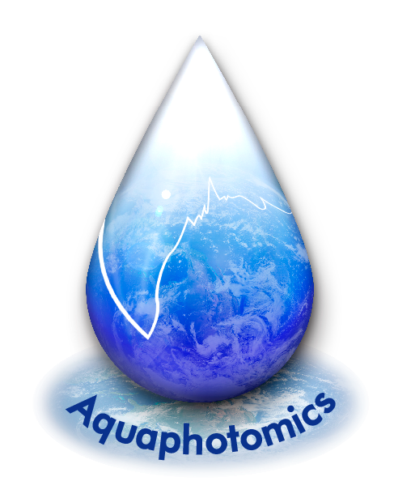
Aquaphotomics:
Introduction
Roumiana Tsenkova
Kobe University, Japan
rtsen@kobe-u.ac.jp
www.aquaphotomics.com

Slide 2
水
と
光
Water and Light

Slide 3
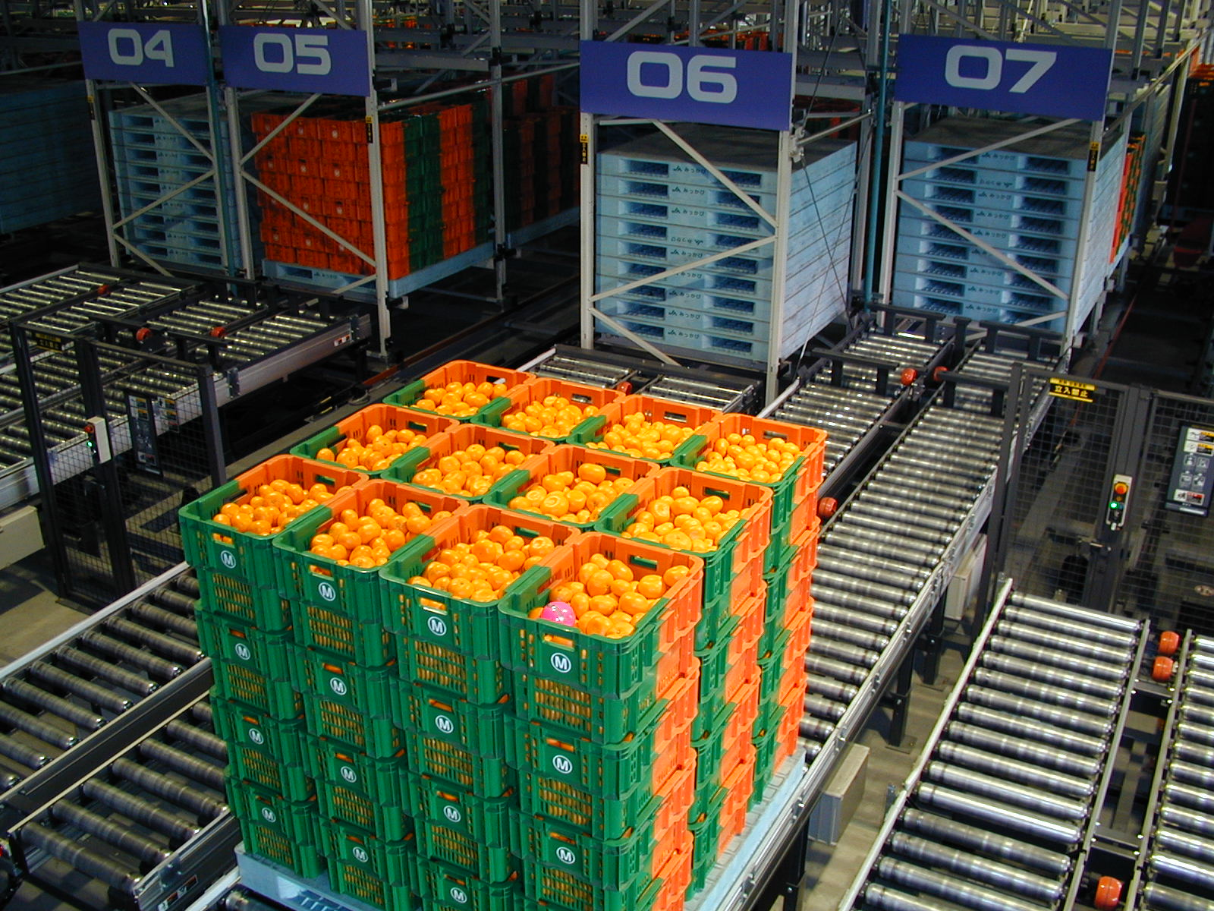

Slide 4
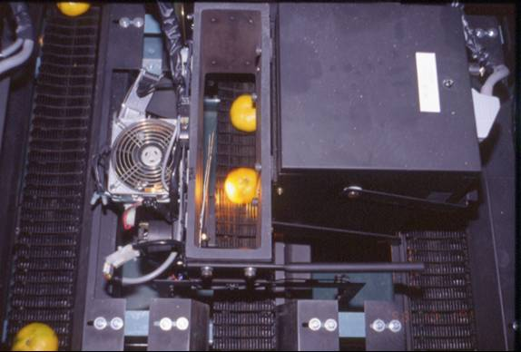

Slide 5
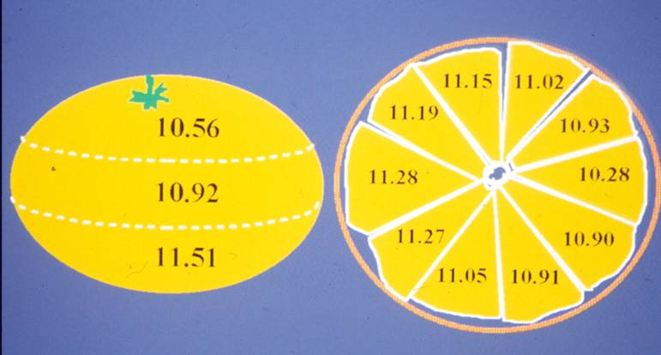

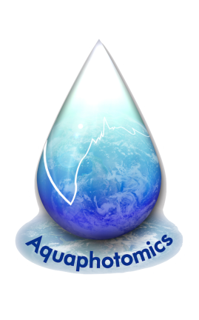
NIR grader’s structure for satsuma mandarin
Order of segment
Distribution of the difference from the average sugar content in a whole fruit

Slide 6
Aquaphotomics concept
Water as matter and energy mirror

Slide 7
AQUAPHOTOMICS
Aqua - : water
Photo - : light
Omics - : all about,
complement of something

Slide 8
LIGHT “turns on” the mirror,
LIGHT “turns on”
the water in to 4 - dimensional
molecular mirror
LIGHT as a
source of perturbation
(electromagnetic field )
and a probe
(the spectrum)

Slide 9
Aquaphotomics Concept
Newly proposed Aquaphotomics:
Water as Molecular and Energy
Mirror Holistic Approach
Current approach in biology:
X – Omics
single components analysis
(genomics, proteomics,
metabolomics, …)
water molecular system
multivariate spectral analysis directly related to system functionality
Notes:
Explain the importance and relevance of your research, putting it in context.
9

Slide 10
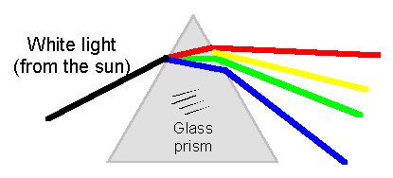
近赤外線

Slide 11
λν = c = 3 x 10⁸ m s⁻¹ E_{photon} = hν h=6.6 x 10⁻³⁴Js
Bio measurement technology 2014
Notes:
EM spectrum is a continuum of energy packets called photons propagated at 3 x 10⁸m s^{-1.} Steams of photons behave like a sine wave having orthogonal electric & magnetic vectors that interact with matter. Photon energy E is proportional to frequency ν with Planck’s constant h as the proportionality factor. The product of wavelength λ and frequency ν gives the velocity c. Photon energy of X rays can knock out inner shell electrons causing ionisation while UV-Visible photons cause transitions in outer valence electrons. IR photons have lower energies that correspond to covalent bond stretch & bend vibrations while even weaker microwave photons make molecules rotate. The NIR corresponds to vibrational overtones & combinations, echoes of those that occur in the mid IR.
By convention mid IR uses a frequency related property called wavenumber (cm⁻¹). This is the number of cycles in a one cm wave train. UV, VIS & NIR use wavelength λ in nanometres.

Slide 13
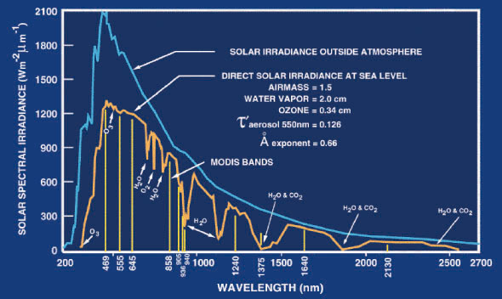

Slide 14
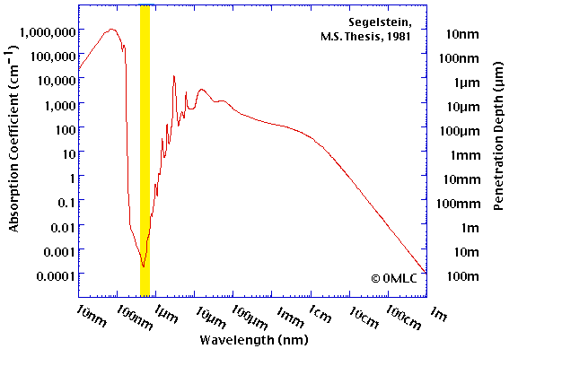
WATER SPECTRUM
IR range
fundamental frequencies
NIR range
overtone region

Slide 15
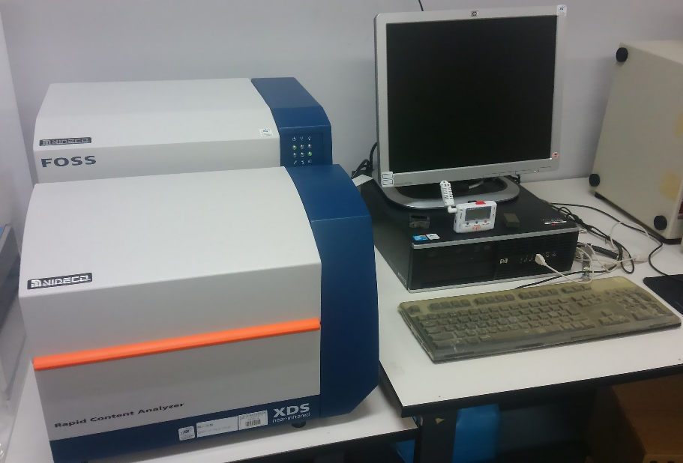
NIRS Bench Type Instrument

Slide 16
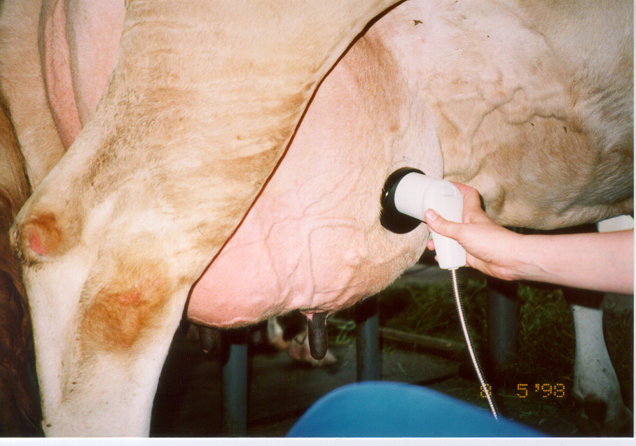
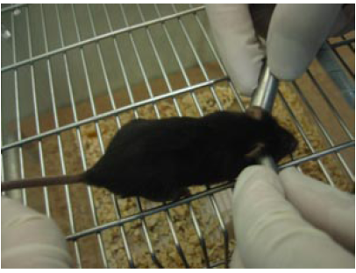
BIO MONITORING AND
BIO DIAGNOSIS
PORTABLE FIBER PROBES FOR TISSUE MEASUREMENTS
Notes:
光の散乱の影響を避けるため、ラットはあらかじめ測定部位である腹部の毛を除去しました。鉄ニトリロ三酢酸または対照として生理食塩水を腹腔内投与し、０、２、４、６時間後の近赤外スペクトル(700-1000 nm)を測定しました。
比較としてTBARS量、8-OHdG量と、腎機能の指標である血中の尿素窒素量、クレアチニン量の測定を行いました。

Slide 17
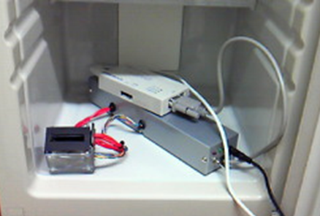
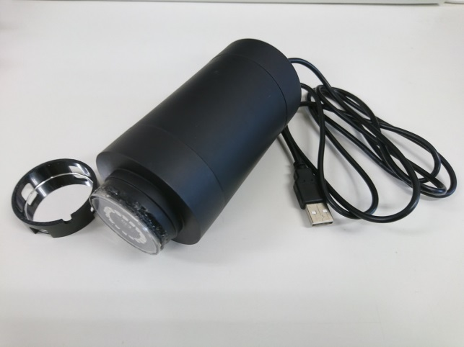
LED SENSOR for Bacteria Count Measurement in Milk
LED at 660, 680, 700, 720, 735, 750, 770, 780, 810, 830, 850, 870, 890, 910, 940, 970 nm

Slide 18


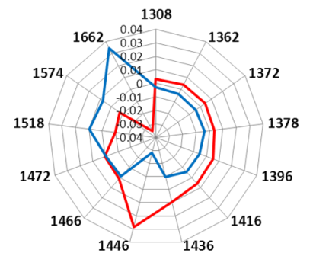
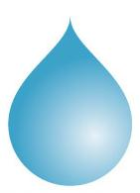
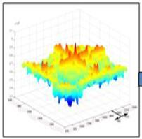
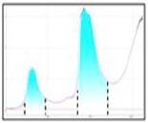
AQUAPHOTOMICS: THE CONCEPT
AQUAPHOTOMICS:
WATER as a
MOLECULAR MIRROR
Perturbations
Spectral
Data Base
WAMACS
Activated Water Absorbance Bands
water
Bio・Aqueous
System
NIR spectrum
Water Absorbance
Spectral Pattern,
WASP
WAMACS = Water Matrix Coordinates, i.e. water absorbance bands in VIS-NIR range

Slide 19
Contents
Aquaphotomics: introduction
Water shaped by:
  Environment
  Single molecule
  Cells (bacteria)

Slide 20
C1
C2
C3
C4
C5
C6
C7
C8
C9
C10
C11
C12
1336～1348
1360～1366
1380～1388
1421～1430
1448～1454
1472～1482
1506～1516
1370～1376
1398～1418
1432～1444
1462～1468
1482～1495

Slide 21
1345.5 | H17O8+, 1st overt. | Wei and Salahub 1997: The Journal of Chemical Physics, 106: 6086.
1346.3 | H9O4+ free OH stech, 1st overt. | Mizuse and Fijii 2012: The Journal of Physical Chemistry, 116: 4868.
1346.3 | H17O8+ free OH stech, 1st overt. | Mizuse and Fijii 2012: The Journal of Physical Chemistry, 116: 4868.
1346.6 | H15O7+, 1st overt. | Wei and Salahub 1997: The Journal of Chemical Physics, 106: 6086.
1347.0 | aqueous proton [H+·(H2O)5] - AD-type H2O free-OH strech, 1st overt. | Headrick et al. (Mark Johnson) 2005: Science, 308: 1765.
1347.0 | H15O7+ free OH stech, 1st overt. | Mizuse and Fijii 2012: The Journal of Physical Chemistry, 116: 4868.
1347.7 | H13O6+ free OH stech, 1st overt. | Mizuse and Fijii 2012: The Journal of Physical Chemistry, 116: 4868.
1348.1 | H11O5+ free OH stech, 1st overt. | Mizuse and Fijii 2012: The Journal of Physical Chemistry, 116: 4868.
1351 | H502 | Tsenkova
1351.35 | 1st overtone (OH-(H2O)5) | Science28
1351.35 | OH-(H2O)5 (free RTs) | Tsenkova
1351.4 | -OH free streching, 1st overt. | Shin et al. (Mark Johnson) 2004: Science, 304: 1137.
1353.0 | high correlation with combined single salt solution data (NaCl and KCl)/overall salinity | R. Peters and S. Nobles, University of Saskatchewan
1353.2 | nonbonded -OH steches, 1st overt. | Headrick et al. (Mark Johnson) 2005: Science, 308: 1765.
1353.2 | 1st overtone free OH stretch (OH-(H2O)3) | Science28
1354 | 1st overtone free OH stretch (OH-(H2O)2) | Science28
1355 | 1st overtone Superoxide Tetrahydrate O2-.(H2O)4 | Weber, Science 2000
1356.8 | Water - n1+n3+n | Choppin and Violante 1972: The Journal of Chemical Physics, 56: 5890.
1357.6 | H17O8+ free OH stech, 1st overt. | Mizuse and Fijii 2012: The Journal of Physical Chemistry, 116: 4868.
1357.93 | 1st overtone H2O (1%) - n3 | Ozaki 1982
1358.3 | H17O8+, 1st overt. | Wei and Salahub 1997: The Journal of Chemical Physics, 106: 6086.
1359.1 | H15O7+ free OH stech, 1st overt. | Mizuse and Fijii 2012: The Journal of Physical Chemistry, 116: 4868.
1359.4 | H15O7+, 1st overt. | Wei and Salahub 1997: The Journal of Chemical Physics, 106: 6086.
1360.55 | 1st overtone free OH stretch (OH-(H2O)4) | Science28
1362 | 1st overtone free wather OH stretch (OH-H2O) | Xantheas, 1995

Slide 22
C1 - 1336-1348 (1342)nm – ν₃
1344nm H2O - 2* ν₃ (Siesler, Ozaki, Kawata, & Heise, 2001)
1340nm liquid water/moisture (Williams, 2009)
ν₁ + ν₂
ν₁ + ν₃
ν₁ + ν₂
2ν_{OH}
(v)II
2*v2+v3
OH-(H₂O)_{I i=1…}
H15O7+ free OH strech
H13O6+ free OH strech, 1st overt
O2 -(H₂O)_{I i=1…}
'-OH strech in fully hydrated hydronium, 2nd overt.
H+ -(H₂O)_{I i=1…}
DD stretch (OH-(H2O)4)
1st overtone free OH stretch (OH-(H2O)4) - 3675cm⁻¹
(Robertson, Diken, Price, Shin, & Johnson, 2003)
H bond 18=<n=<24, 1st overt.
aqueous proton [H+·(H2O)5] - AD-type H2O free-OH strech, 1st overt
degenerate asymmetric OH strech, 2nd overt.
aqueous proton [H+·(H2O)4] - H3O+ symmetric stretch, 1st overt.
Dangling -OH (non-hydrogen-bonded), 1st overt.

Slide 23
Assignment
C1 - 1336-1348 (1342)nm – ν₃
1344nm H2O - 2* ν₃ (Siesler, Ozaki, Kawata, & Heise, 2001)
1340nm liquid water/moisture (Williams, 2009)
C2 - 1360-1366 (1364)nm – OH-(H₂O)₁, OH-(H₂O)₂, OH-(H₂O)₄
1360nm 1st overtone free OH stretch (OH-(H2O)4) - 3675cm⁻¹ (Robertson, Diken, Price, Shin, & Johnson, 2003)
1366nm 1st overtone OH- stretch (OH-(H2O)2) - 3660cm⁻¹ (Robertson et al., 2003)
C3 - 1370-1379 (1374)nm – ν₁ + ν₃
1379.3nm H2O - ν1 + ν3 – 7250cm⁻¹ (Siesler et al., 2001)
1379.3nm overtone of stretching vibration – 7250cm⁻¹ (Kuroda, Hamano, Mori, Yoshikawa, & Nagao, 2000)
1373 nm first overtone of 2ν_{OH} (Lakshmi Reddy, Padma Suvarna, Udayabhaska Reddy, Endo, & Frost, 2014)
C4 - 1380-1388 (1384)nm – OH-(H₂O)₁, OH-(H₂O)₄, O₂-(H₂O)₄
1383.15nm 1st overtone interwater / DD stretch (OH-(H2O)4) - 3615cm⁻¹ (Robertson et al., 2003)
1381nm H2O-ν₁₊ ν₃ (Cattaneo, Cabassi, Profaizer, & Giangiacomo, 2009)

Slide 24
WAMACS
Water Matrix Coordinates:
Water absorbance bands corresponding to pools of water molecules with the same vibration frequency

Slide 25
AQUAPHOTOME
is
the entire complements of
water matrix coordinates
found under
various perturbations
over the whole EMS

Slide 26
Water Absorbance Pattern, WAP
AQUAGRAM
Aquagram was devised to visualize the WASP.
The aquagram displays normalized absorbance values at specific water bands on the axes originating from the center of the graph.
Absorbance values at the WAMACs are placed on the respective radial axes.

Slide 27
Contents
Aquaphotomics: introduction
Water shaped by:
  Environment
  Single molecule
  Cells (bacteria)

Slide 28
WATER and VAPOR SPECTRA
AQUGRAM
MPA
VAPOR
WATER
A : Absorbance after EMSC (1300-1600 nm)
μ：Mean of Averaged spectra
σ：SD of absorbance each wave length

Slide 29
Aquagrams of ground water samples

Slide 30
PLSR Models on Water Temperature
One Year Spectral Data

Slide 31
PLSR models on relative humidity
One Year Spectral Data

Slide 32
Contents
Aquaphotomics: introduction
Water shaped by:
  Environment
  Single molecule
  Cells (bacteria)

Slide 33
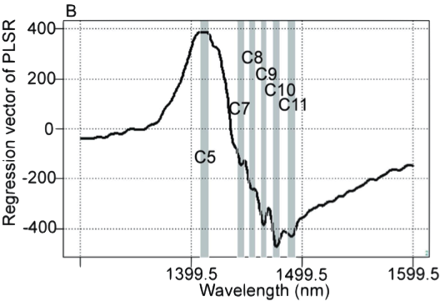
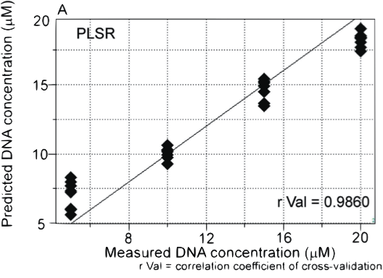
NIRS regression model according to DNA concentration. (A) Y-fit for DNA concentration of partial least squares regression (PLSR) with pretreatment by mean centering, smoothing (21 points), OSC (one component), and active class validation. N = 32, number of applied latent variables = 2, r Cal = 0.9978, SEC = 0.3882, r Val = 0.9860, SECV = 1.5131. (B) Regression vector of the PLSR calibration model for DNA concentration showing characteristic water peaks at the 1400–1500 nm spectral interval.
Detection of UV-induced cyclobutane pyrimidine dimers by near-infrared spectroscopy and aquaphotomics
N Goto, G Bazar, Z Kovacs, M Kunisada, H Morita… - Scientific reports, 2015

Slide 34
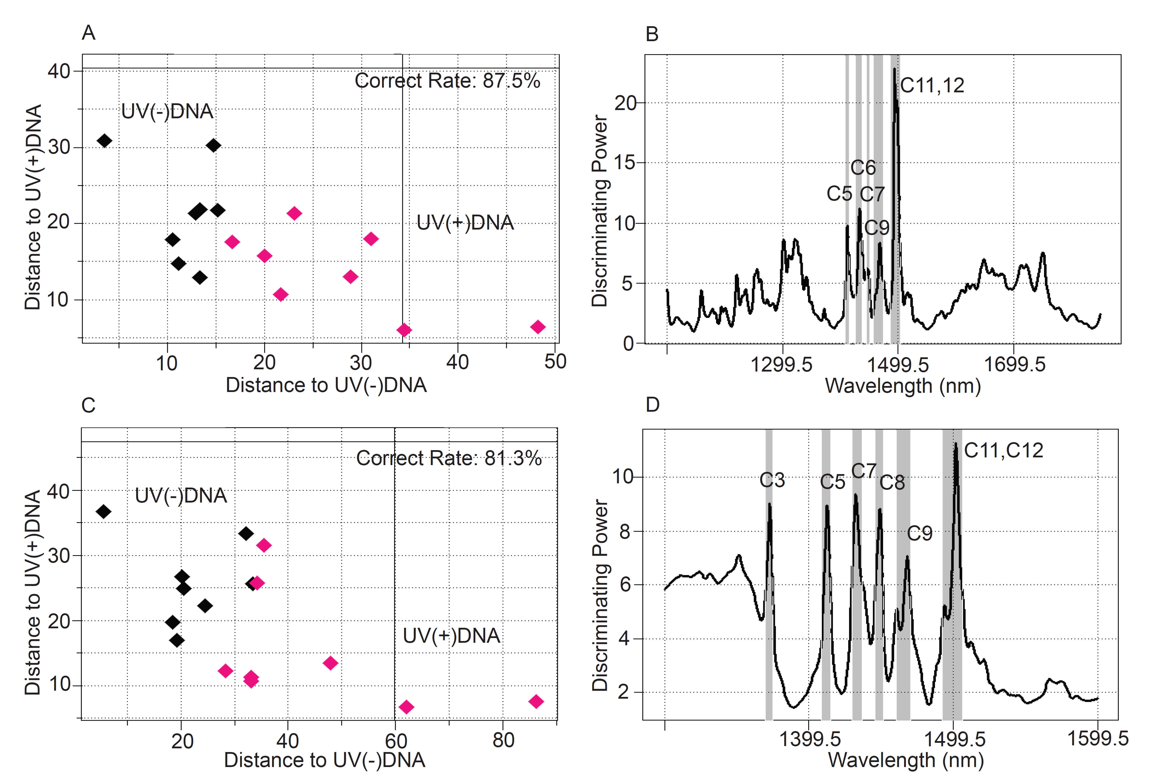
NIRS based discrimination of Milli-Q water and cis-syn T<>Ts solutions.
SIMCA using 1300-1600 nm interval of NIR spectra with mean-centering and smoothing (45 points). Factor # =2: samples of Milli-Q water and isolated cis-syn T<>Ts solutions form separate groups (ratio of correctly classified samples = 94.9 %).
C) PLS-DA using 1300-1600 nm interval of NIR spectra : 94.9 % of samples were classified correctly in cross-validation. Factor # =1.
Detection of UV-induced cyclobutane pyrimidine dimers by near-infrared spectroscopy and aquaphotomics N Goto, G Bazar, Z Kovacs, M Kunisada, H Morita… - Scientific reports, 2015

Slide 35
Results of NIRS regression models dependent on the irradiated UVC doses show close correlation between the actually irradiated doses of UVC and the levels determined by the NIRS calibration model when DNA samples irradiated with UVC at doses of 0, 5, 10, 15 and 20 kJ/m² were measured in 20 μM aqueous solutions.
Detection of UV-induced cyclobutane pyrimidine dimers by near-infrared spectroscopy and aquaphotomics
N Goto, G Bazar, Z Kovacs, M Kunisada, H Morita… - Scientific reports, 2015

Slide 36
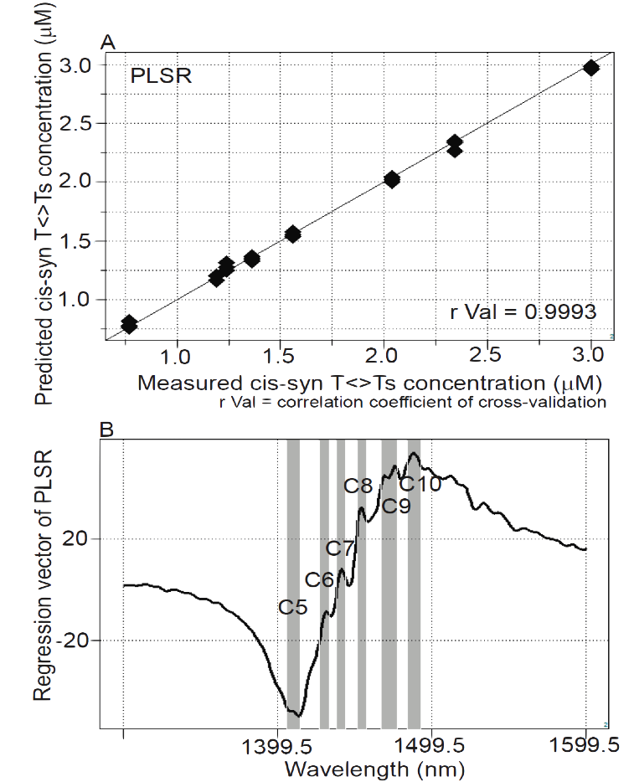
Quantitative analysis of isolated cis-syn T<>Ts using NIRS and HPLC data showing high correlation between cis-syn T<>Ts concentrations determined by the NIR calibration model and the laboratory reference values (0.77 μM -3.0 μM) determined by HPLC.
A) Y-fit for cis-syn T<>Ts concentration of PLSR with pretreatment of mean centering, smoothing (21 points), OSC (one component) and leave-one-out cross validation: N = 24, number of applied latent variables = 2, r Cal = 0.9993, SEC = 0.0267, r Val = 0.9993, SECV = 0.0308.
B) Regression vector of PLSR calibration model on cis-syn T<>Ts concentration revealed characteristic water peaks in 1400 nm-1500 nm spectral interval.
Detection of UV-induced cyclobutane pyrimidine dimers by near-infrared spectroscopy and aquaphotomics
N Goto, G Bazar, Z Kovacs, M Kunisada, H Morita… - Scientific reports, 2015

Slide 37
Unique transformations of water structure for the amyloidogenic nucleation
Chatani E, Tsuchisaka Y, Masuda Y, Tsenkova R (2014) Water molecular system dynamics associated with amyloidogenic nucleation as revealed by real time near infrared spectroscopy and aquaphotomics.PLoS ONE 9(7): e101997. doi:10.1371/journal.pone.0101997

Slide 38
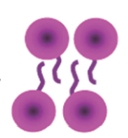


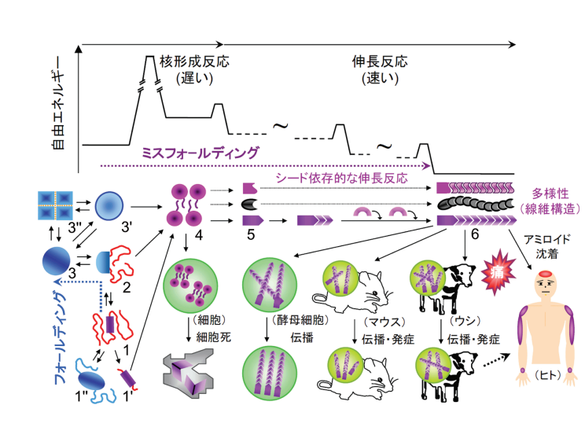
Nucleation phase
Elongation phase
Equilibrium phase
The amount of Amyloid fibrils
Stage 1
Stage 2
Stage 3
Time
If NIR could detect change with nucleation,
It is possible to diagnose amyloidosis!!

Slide 39
Figure: Schematic illustration representing multi-step transformation of water structures during the fibril formation.
In the nucleation phase, free water molecules and hydrating water onto protein molecules are dominated initially, but afterwards hydrogen-bonded water networks are developed, which is considered essential for nucleation by interlinking protein molecules softly. In the elongation phase, the hydrogen bonds were decayed gradually towards the state observed in bulk water, and slight increasing of hydrated water onto amyloid fibrils was also observed.
Chatani E, Tsuchisaka Y, Masuda Y, Tsenkova R (2014) Water molecular system dynamics associated with amyloidogenic nucleation as revealed by real time near infrared spectroscopy and aquaphotomics.PLoS ONE 9(7): e101997. doi:10.1371/journal.pone.0101997

Slide 40
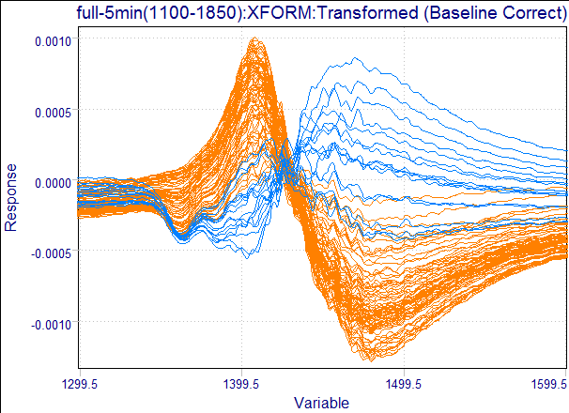
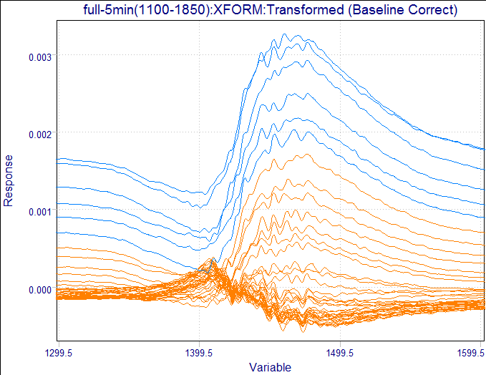
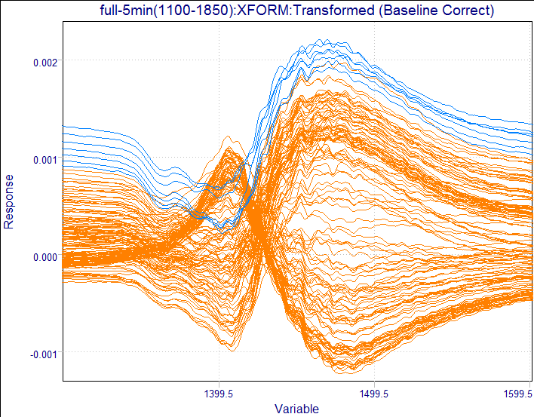
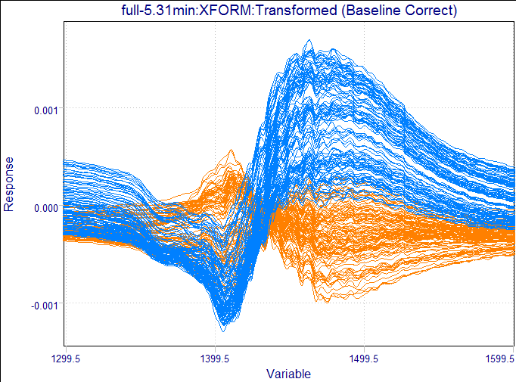
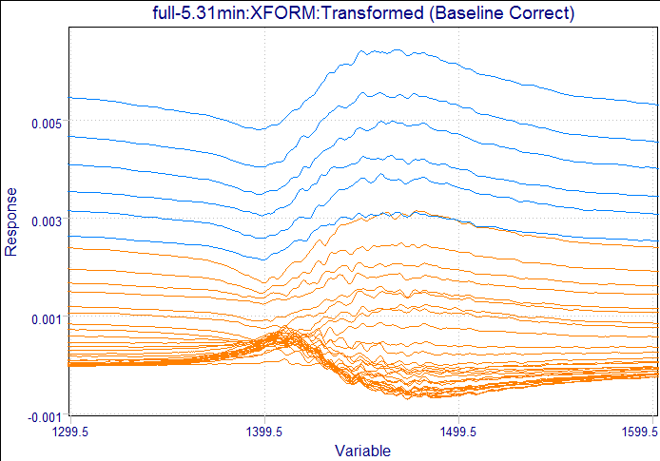
アミロイド線維形成サンプル
(NaCl)
核形成期
伸長期
50 mM
100 mM
400 mM
1405
1470
1470
1470
1405
吸光度 [-]
吸光度 [-]
吸光度 [-]
1405
1480
1480
波長[nm]
1460
波長[nm]
波長[nm]
アミロイド線維形成サンプル
(Na₂SO₄)
アミロイド線維形成サンプル
(NaClO₄)
1460
1405
1400
吸光度 [-]
吸光度 [-]
1410
1470
1470
波長[nm]
波長[nm]

Slide 41
Contents
Aquaphotomics: introduction
Water shaped by:
  Environment
  Single molecule
  Cells (bacteria)

Slide 42
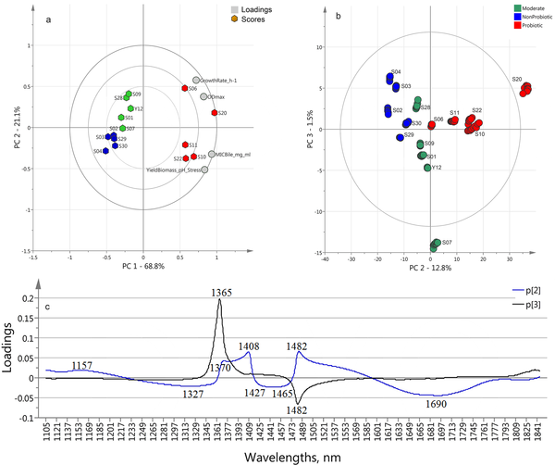

a) PCA Bi-plot calculated on the reference data (strains growth rates, maximal optical densities, bile MIC and the yield of biomass after three hours stay at pH 1.80 in presence of pepsin (9000 U/ml), reference data in Table 1); b) MW-PCA analyses using the 1100–1850 nm wavelength interval—Score plot calculated on spectral data (n = 150) at the cultivation time of 11.4–12 h.
Slavchev A, Kovacs Z, Koshiba H, Nagai A, Bázár G, et al. (2015) Monitoring of Water Spectral Pattern Reveals Differences in Probiotics Growth When Used for Rapid Bacteria Selection. PLoS ONE 10(7): e0130698. doi:10.1371/journal.pone.0130698
http://127.0.0.1:8081/plosone/article?id=info:doi/10.1371/journal.pone.0130698

Slide 43
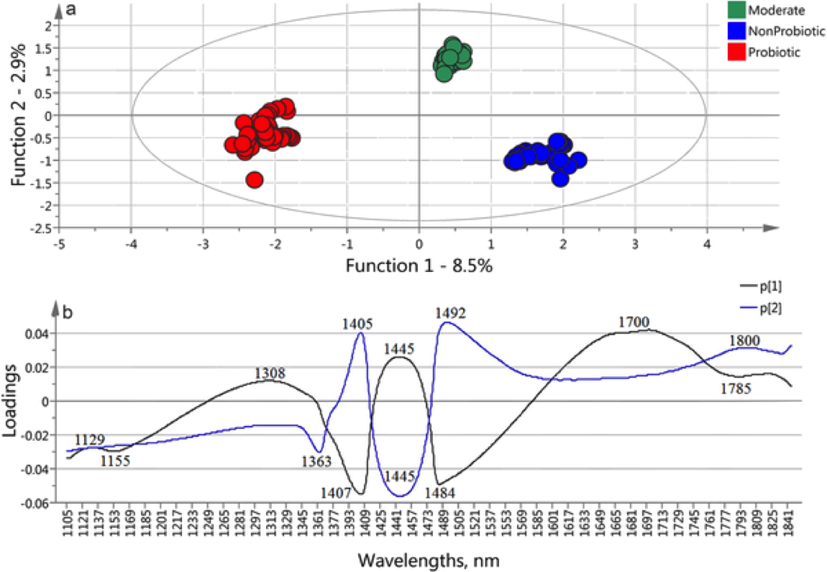
OPLS-DA model built on the spectral data of the 15 strains in the monitoring time between 11.4–12 h (n = 150) using the 1100–1850 nm wavelength interval to classify the probiotic, moderate and non-probiotic groups a) score plot and b) loadings plots.
Slavchev A, Kovacs Z, Koshiba H, Nagai A, Bázár G, et al. (2015) Monitoring of Water Spectral Pattern Reveals Differences in Probiotics Growth When Used for Rapid Bacteria Selection. PLoS ONE 10(7): e0130698. doi:10.1371/journal.pone.0130698
http://127.0.0.1:8081/plosone/article?id=info:doi/10.1371/journal.pone.0130698

Slide 44
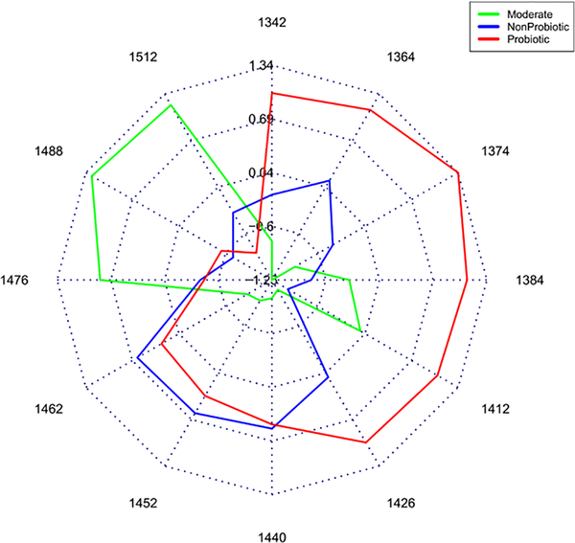
Aquagram on the spectra of culture media of groups of probiotic, moderate and non-probiotic strains
Slavchev A, Kovacs Z, Koshiba H, Nagai A, Bázár G, et al. (2015) Monitoring of Water Spectral Pattern Reveals Differences in Probiotics Growth When Used for Rapid Bacteria Selection. PLoS ONE 10(7): e0130698. doi:10.1371/journal.pone.0130698
http://127.0.0.1:8081/plosone/article?id=info:doi/10.1371/journal.pone.0130698

Slide 45
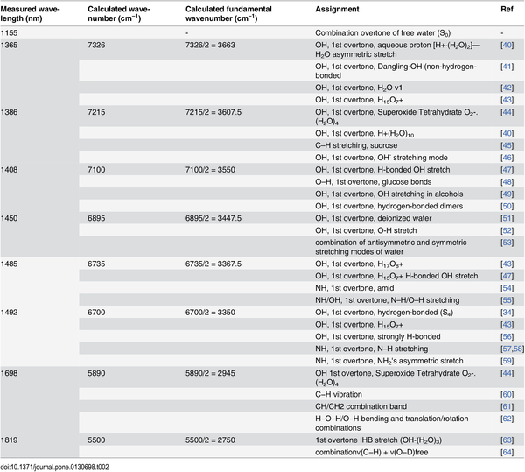
Measured wavelength and calculated wavenumbers of the bands found with PCA, SIMCA, OPLS-DA and PLSR methods and their assignment based on the corresponding references.
Slavchev A, Kovacs Z, Koshiba H, Nagai A, Bázár G, et al. (2015) Monitoring of Water Spectral Pattern Reveals Differences in Probiotics Growth When Used for Rapid Bacteria Selection. PLoS ONE 10(7): e0130698. doi:10.1371/journal.pone.0130698
http://127.0.0.1:8081/plosone/article?id=info:doi/10.1371/journal.pone.0130698

Slide 46
FUTURE
Water Vocabulary: letters (water bands), words (spectral patterns), sentences (water functionality)
Basic well known phenomena and reactions should be explained with added knowledge about water
Education about water on a large scale

Slide 47
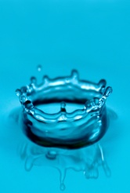
AQUAPHOTOMICS
Experiments
Perturbations
Water
Sun
Bio
Aqueous System
NIRS
Medical Science, Pharmacy
.
UV―VIS―IR
Data Analysis
Spectral Data Base
Engineering
・
GOAL
Building
bio-system HOLISTIC MODELS
through analyzing spectral changes of WATER MOLECULAR SYSTEM
Biotechnology
・
Multivariate Analysis
WAMACS：
Activated Water Absorbance Bands
Basic Science
・ Analyzing of aqueous system
・ Interaction of water with DNA
・ Interaction of water with organic and non-organic molecules
・ Aqueous systems in cells
・ Aqueous systems in tissue
・ Aqueous systems in organs
・ Aqueous systems in whole body
Database
AQUAPHOTOME：Database of water absorbance bands and patterns
WAPS： Database of water absorbance patterns according to change perturbation
Applying in various fields

Slide 48
水の音
光の遊び
生きている
Sound of a stream,
Sunlight dancing on waters,
Life wakes up again.
R. Tsenkova, 2004

